Slide 1
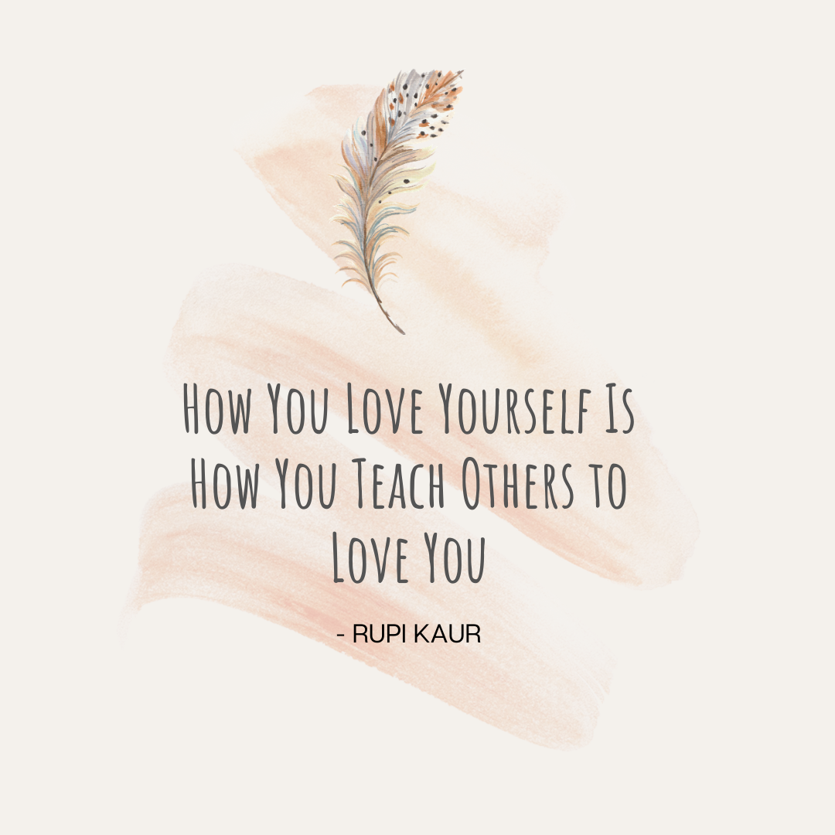

Slide 2

Crisis Counselor Lillian Adams
Director Alicia Baughman
Case Manager Ophelia Cofer
Notes:
If your feeling triggered we are available talk, can bring up feelings we maybe didn't know we had and that's okay

Slide 3


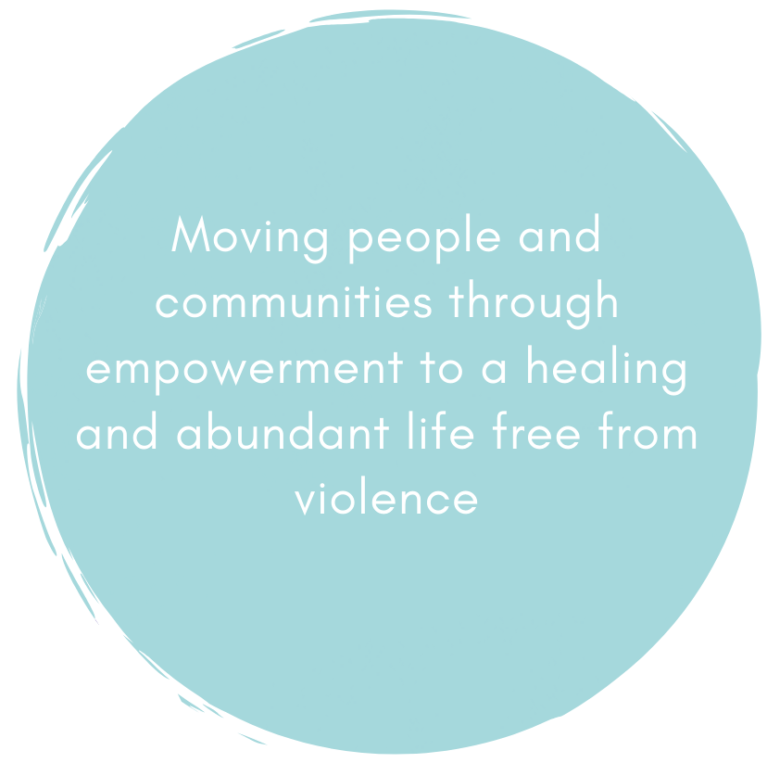
Who We Are
Mission, Values, Vision

Slide 4


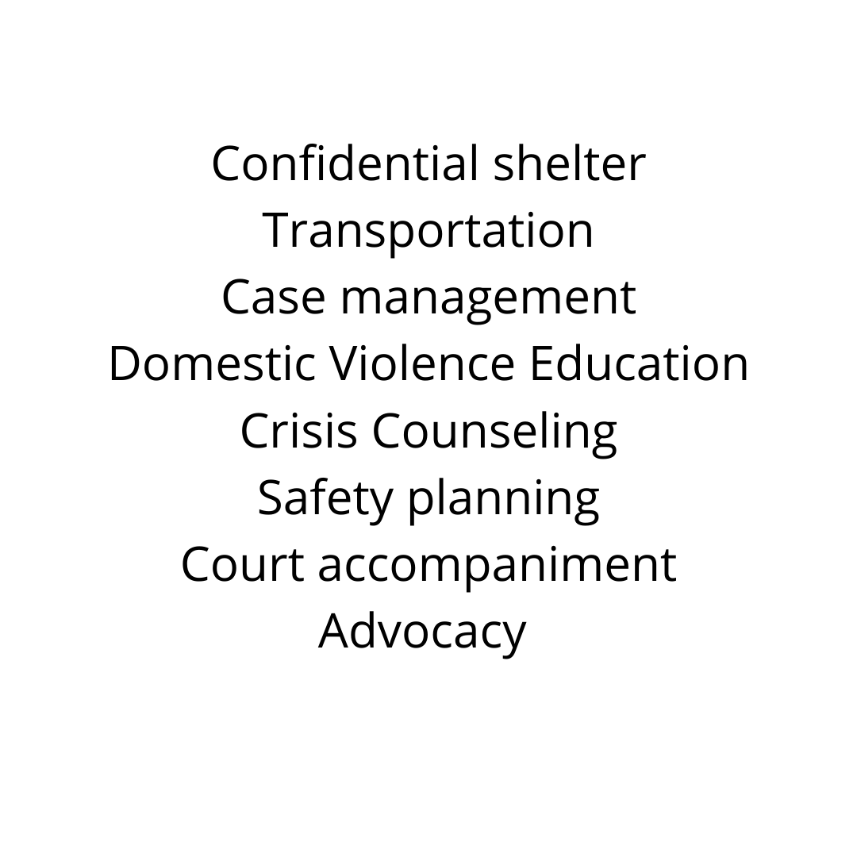




Services We Provide

Slide 5
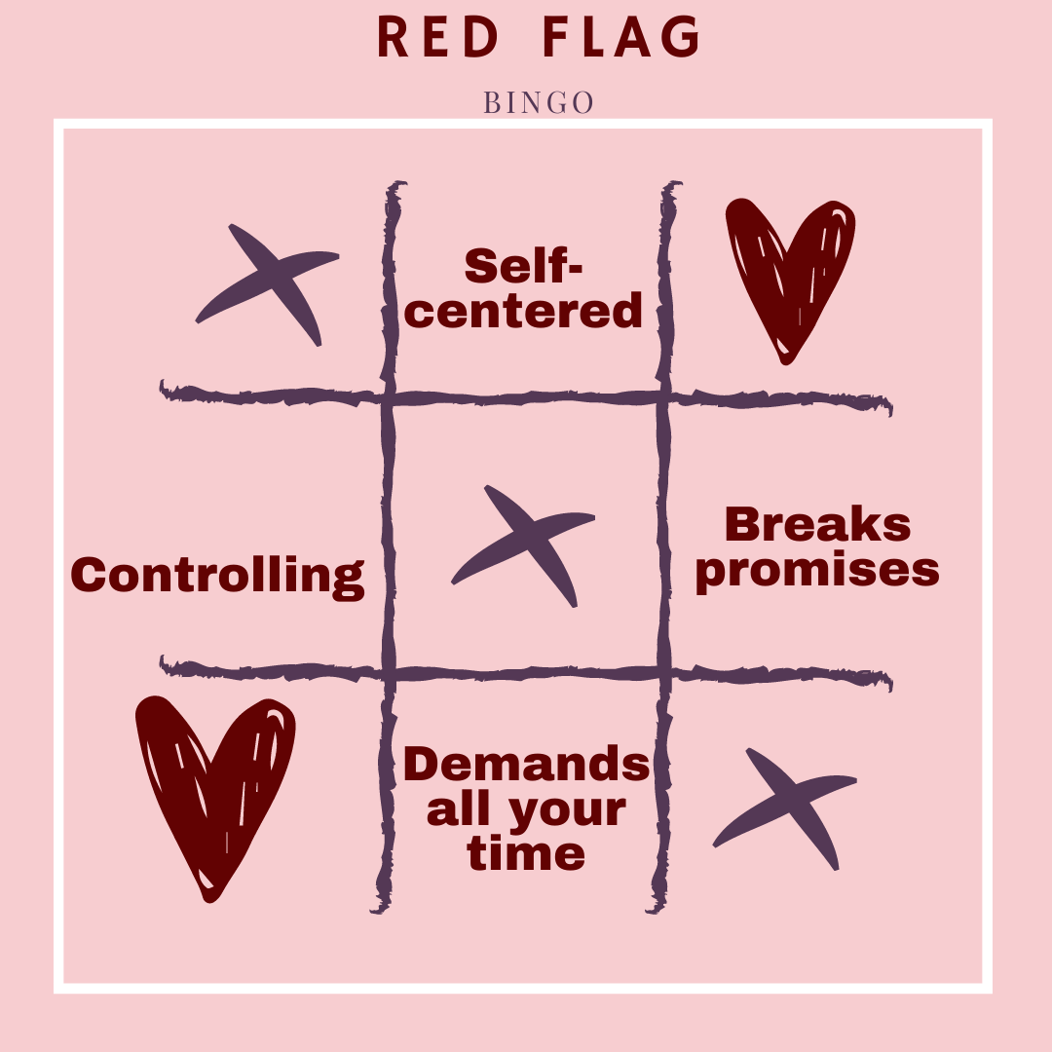
What is Domestic Violence?
What does Abuse Look Like?
Interactive poll

Slide 6
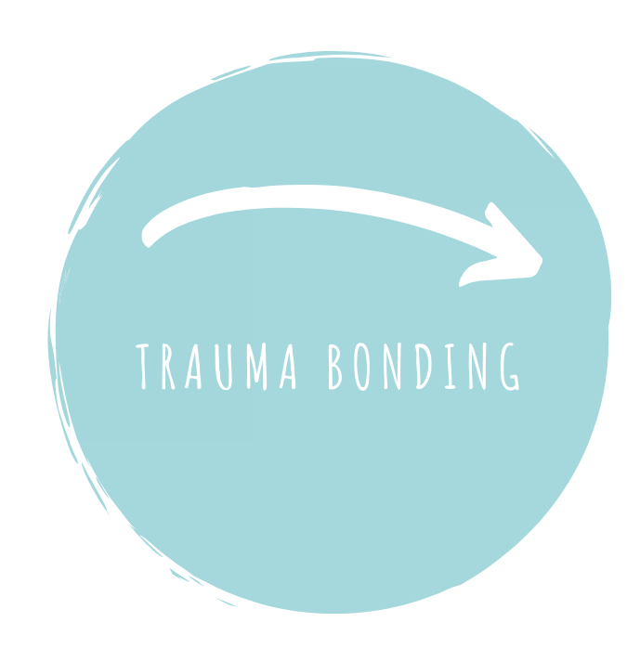


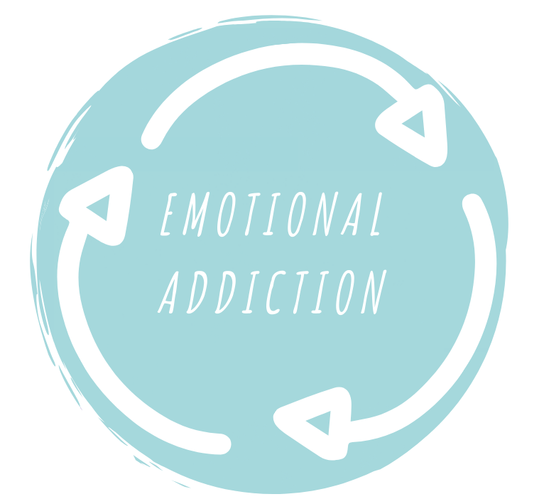
Notes:
Trauma bonding, grooming, emotional addiction
"learned behavior that we are taught, not something we are born with. If we find ourselves doing these things, we can teach ourselves to stop" makes a choice at the age of 6, but we can stop it for our whole family (heal generations)

Slide 7

What is love?
Interactive poll

Slide 8


Slide 9
All of my changes are easy to make
When I begin to work on myself, sometimes things get worse before they get better. It is okay if that happens, because I know that it’s the beginning of the process. It’s untangling old threads. I just flow with it. It takes time and effort to learn what I need to learn. I don’t demand instant change. Impatience is only resistance to learning. I let myself do it step by step. It will get easier as I go along.
Inner Wisdom: Meditations for thee Heart and Soul by Louise L. Hay

Slide 10



Slide 11
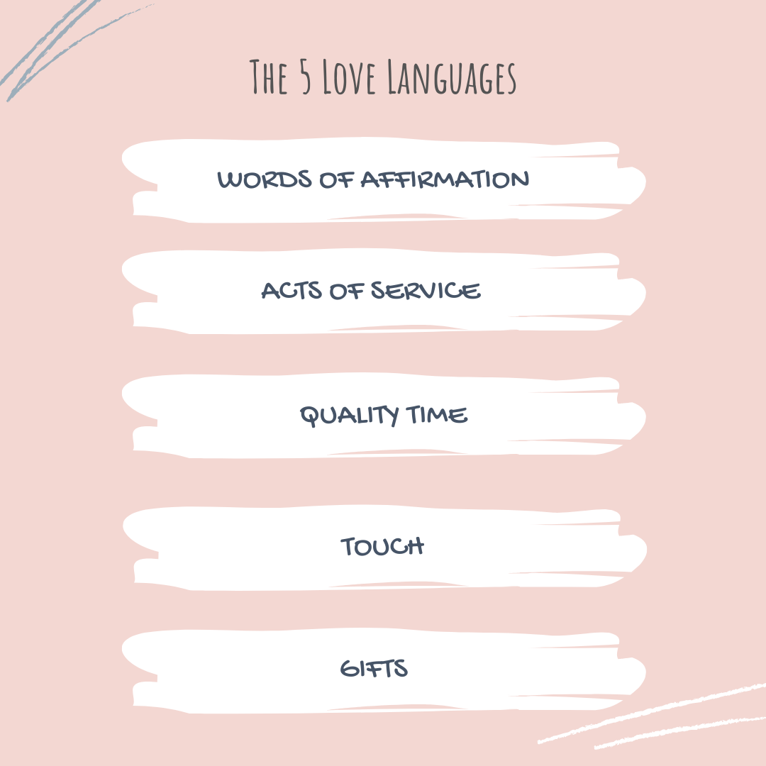

Slide 12
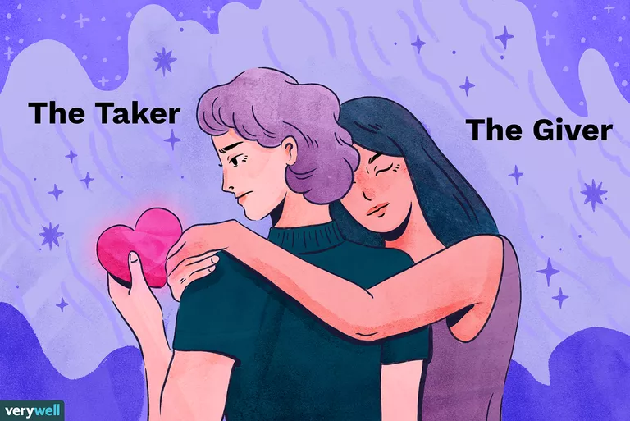
What is Codependency?
Codependency refers to a mental, emotional, physical, and/or spiritual reliance on a partner, friend, or family member.

Slide 13
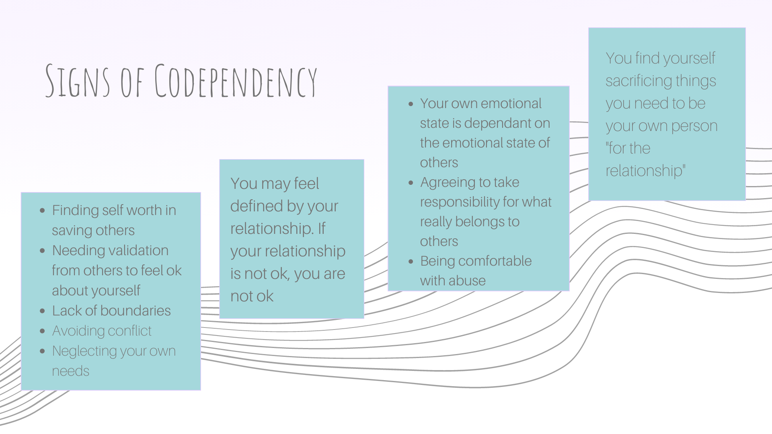
“If my partner doesn’t love me, that means i’m not loveable”

Slide 14




We can heal codependent tendencies by developing...

Slide 15
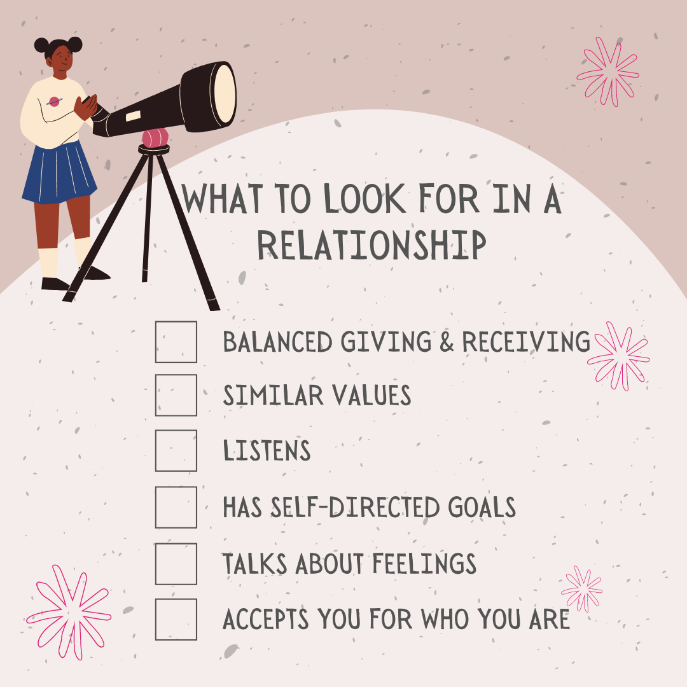
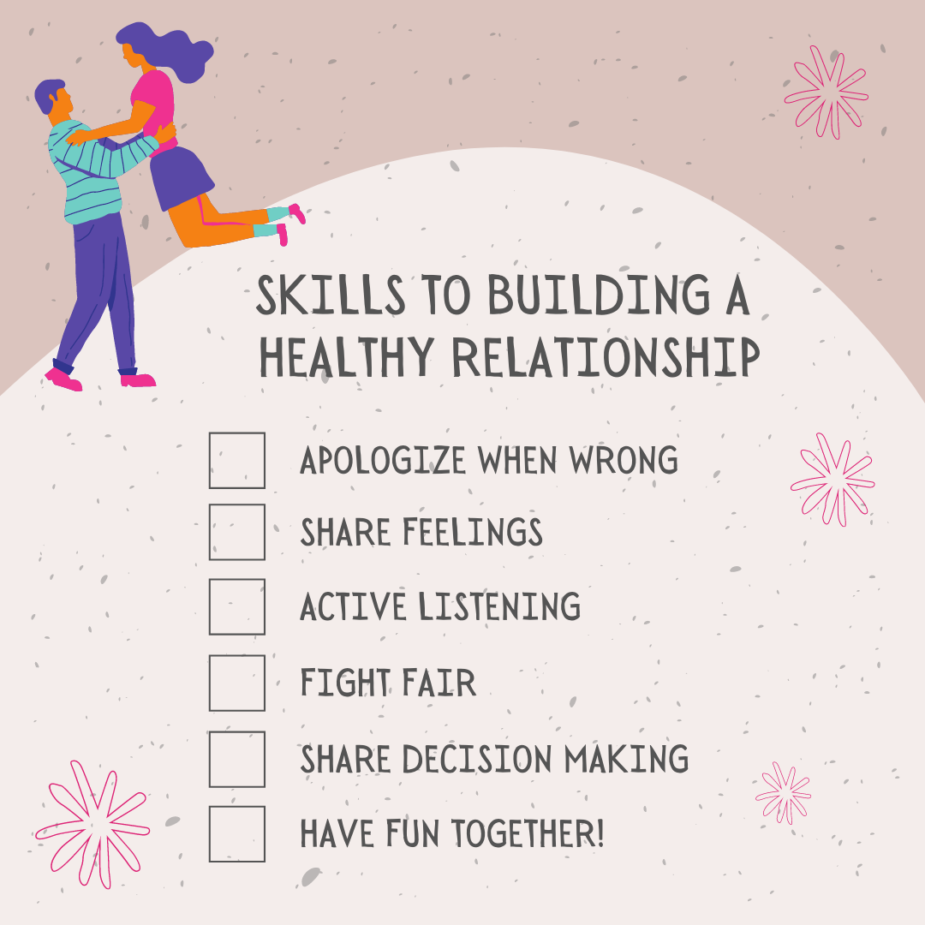

Slide 16


A call to action...

Slide 17

Hotline #
(530)865-4899
Warmline #
(833)317-HOPE
Instagram
@Westside_dvs
Lillian Adams
ladamswsdvs@gmail.com
Ophelia Cofer
ocoferwsdvs@gmail.com
Alicia Baughman
Director
Wdvsdirector@gmail.com
530-966-0612

