Slide 1
Deaf 101
Presented by Jillian Watkins | program coordinator
NorCal Peace of Mind

Slide 2
NorCal Services for
Deaf and Hard of Hearing
Who are we?
A non-profit organization that serves the Deaf and Hard of Hearing community in 24 counties in Northern California
Established in 1977
Provide social and advocacy services to D/HOH community members
OUR MISSION:
To empower D/HOH individuals to live independently and productively. To advocate for equal access and opportunities. To educate family members, service providers, employers and the general public.

Slide 3
Overview of training:
Statistics
Being Deaf as a spectrum
What is Deaf Culture?
American Sign Language
Being Deaf and Literacy
Language Deprivation and Delay
Accommodations
Using ASL Interpreters

Slide 4
Let’s Talk Numbers!
What are the statistics?
38 million D/HOH people in the United States and 466 million worldwide
3-4 out of 1000 babies are born Deaf, approximately 1,200 babies born with hearing loss annually in California
93% of Deaf babies are born to hearing parents and only 10% of those parents learn to sign, leading cause of language deprivation
ASL is the 3rd most used language in the country after English and Spanish
There are 9,700 certified interpreters in US and less than 750 are in California

Slide 5
Being Deaf is a spectrum.
Nothing is ‘one size fits all’
Some use sign language, some only speak/lipread and some do a combination of both
Not everyone uses assisted hearing devices such as hearing aids, FM systems, cochlear implants, etc.
Some identify their deafness as a disability
Some identify as culturally Deaf
Culturally Deaf?
What does that mean??

Slide 6
What is the “Deaf Culture”?
A social movement that holds being Deaf as a difference in human experience rather than a difference in ability.
A set of learned behaviors of a group of people who have their own languages, values, rules for behavior and traditions. (Padden)
“I’m not disabled. I’m Deaf.”
There are unique experiences in our Deaf culture...

Slide 7
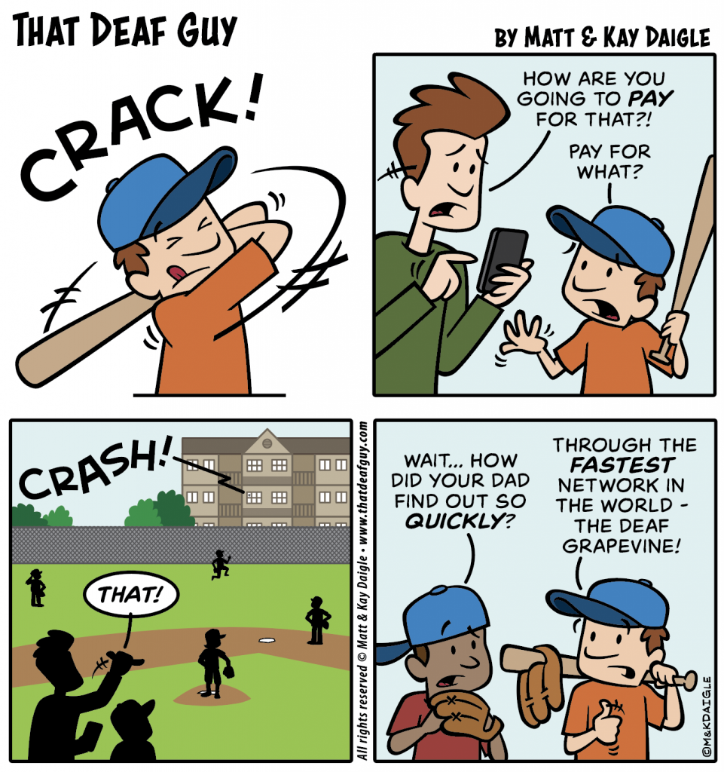
Word gets around FAST in the Deaf culture.
No filter, bluntness is viewed as normal.
Have our own slang - "vee vee" "pah" "deaf-bing"
Known for being loud. Nothing "silent" about being deaf!
Quick flick of light switch, stomping of foot or waving of hands, gentle tap on shoulder to get a Deaf person's attention.
Unfortunately, we also experience things such as Dinner Table Syndrome, information deprivation, at higher risk of bullying and abuse.

Slide 8
American Sign Language
Is recognized as a formal language, complete with complex grammatical rules, syntax, semantics and structure.
Includes spatial structure, facial expressions and body language.
Be careful not to think that ASL is simply English words turned into hand signs.
ASL is NOT universal. Other countries have their own sign languages. Ex: British Sign Language, Mexican Sign Language, Auslan
  Fun fact: There is also 'International Sign' that many use to communicate across languages. Not a full, complex language though.

Slide 9
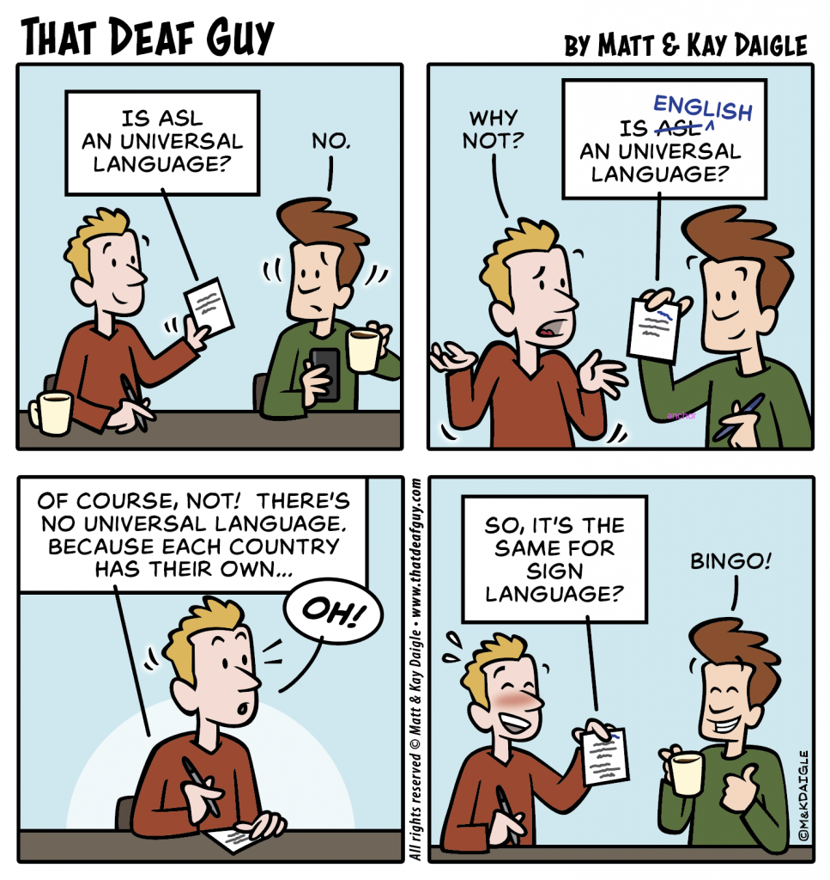

Slide 10
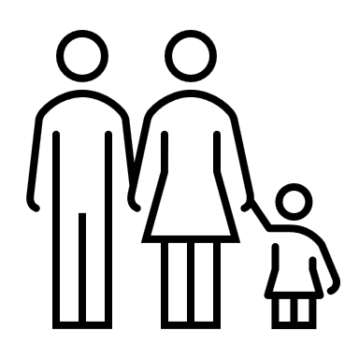
Deaf Children and Language:
Deaf children have the same ability to learn language but they are not automatically exposed to accessible language like hearing children are.
Deaf children who are born into Deaf families that use ASL are exposed to language from birth and learn language similarly to how hearing children learn the spoken language.
Audism – ability to hear and ability to use spoken language is seen as superior
Lack of resources from healthcare professionals on Deaf culture, using sign language, availability of Deaf mentors and schools for the Deaf
Hearing Parents w/ Hearing Baby
Deaf Parents w/ Deaf Baby
Deaf Parents w/ Hearing Baby
Hearing Parents w/ Deaf Baby

Slide 11
“Every D/HH child deserves a strong first language foundation. Language must be the first intervention for D/HH children and language and cognition must be prioritized over speech production and listening skills.”
-Kimberly Sanzo, SLP

Slide 12
Being Deaf and Literacy:
10% of Deaf students become literate adults, reading at the 10th grade level or above.
ONLY 8% of Deaf/HOH students in California passed the CA High School Exit Exam
40% of DHH students are mainstreamed with only 3 other DHH peers and 20% are mainstreamed at schools where they’re the only DHH student
30% of Deaf students who leave school at age 18 or above are functionally illiterate, reading at the 2.8 grade level or below
60% are reading at the 3rd to 4th grade level
How is this happening??
The answer: language deprivation

Slide 13
Language Delay and Deprivation in the Deaf Community:
This is widely known as the cause for illiteracy in Deaf children & adults.
*Note: LANGUAGE deprivation, NOT auditory deprivation. Hearing loss does NOT affect intelligence.*
https://youtu.be/cUTymzn5FEc
“Language deprivation is a phenomenon so rare among hearing children that it is seldom seen outside famous cases of severe developmental pathology or criminal abuse/neglect……
And yet, it is so common among D/HOH children and adults that it often fails to provoke the alarm it deserves.”
(W.C. Hall, 2017)

Slide 14
Effects of Language Deprivation:
Difficulty in writing and reading English/illiteracy
Lack of fluency in ANY language
Trauma and mental health difficulties throughout their life
Adverse impact on other developmental domains that depend on language such as cognition, social-emotional learning, school readiness, etc.
Questions or comments about language deprivation?
Want more information on this phenomenon –
Instagram: @language1st
Facebook: Language First
Website: www.language1st.org

Slide 15
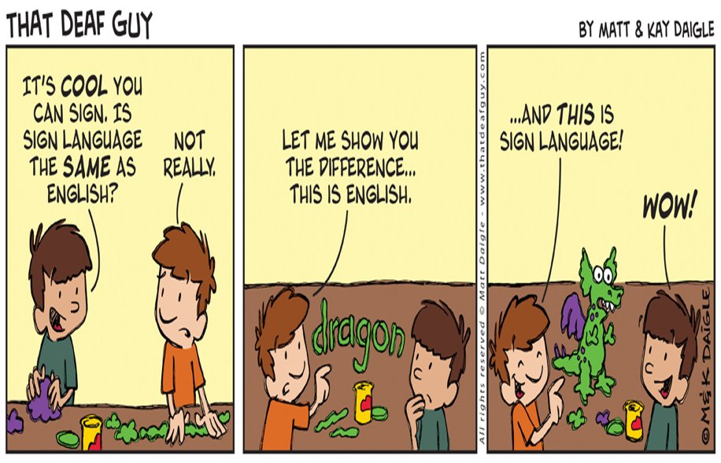

Slide 16
Common accommodations
Sign Language Interpreting/Video Remote Interpreting (VRI)
Video Relay Service (VRS)
Captioning
Voice-To-Text/Typing
Gesturing
Plain ol' pen and paper
Ask... What is your preferred
method of communication?

Slide 17
Common writing patterns you may see when communicating with a Deaf person:
ASL: “Me want coffee where?”
ENGLISH: “Where can I get some coffee?”
ASL: “Me finish give paper teacher.”
ENGLISH: “I gave my paper to the instructor.”
ASL: “Store me go.”
ENGLISH: “I’m going to the store.”

Slide 18
Using an interpreter: Do's & Don'ts
DO:
Look and talk directly TO your client.
Let the Deaf client determine best layout, who stands/sits where for best access.
Speak clearly and at a normal pace. The interpreter is a few words behind you.
Check and make sure VRI is acceptable to the Deaf client if that is what you are offering in place of a live interpreter.
DON'T:
Say "Tell him/her/them..."
Speak at warp speed or mumble.
Assume that your Deaf client can lipread. Only 30% of spoken words are visible on the lips. This puts the burden of communication 100% on the Deaf person.
Assume that a family member or their companion will be interpreting for them.

Slide 19
In Conclusion...
Being deaf is incredibly wide-ranging and not everything works the same for everyone.
Identifying how they view their hearing loss - a disability or simply a different human experience.
Many different levels of language. Different communication methods. Always ask the Deaf person what is the best way to communicate. Don't assume.
"Let me be clear. Voice does not equate power to me. What is powerful to me is language and how I choose to express it. As long as language is present, we should be allowed to choose which modality feels most natural. My story here is about my journey divorcing myself from the idea that speech equates power." ~Lauren Ridloff, Deaf actress

Slide 20
THANK YOU!
NorCal Services for Deaf and Hard of Hearing
Peace of Mind
Jillian Watkins | program coordinator
peaceofmind@norcalcenter.org
(916) 999-1559
Evaluation to follow via email. Please take a moment to fill out! Thank you!

Slide 21
NorCal Services for Deaf and Hard of Hearing
4044 N. Freeway Blvd
Sacramento, CA 95834
(916) 349-7500 voice
Info@norcalcenter.org email
www.norcalcenter.org

