Slide 1
Introduction to Intergovernmental Transfers
October 13, 2022

Slide 2
Agenda
Overview of Intergovernmental Transfers (IGTs)
Comparison of IGTs to Certified Public Expenditures (CPEs)
Allowable and Non-Allowable IGT Funding Sources
Cash Flow
Overview of County Fund Accounts (CFAs)

Slide 3

Pre-Training Assessment
Please click on the link in the chat box and answer questions
3 minutes to answer questions
2

Slide 4
Overview of IGTs
Medicaid is a jointly funded partnership between the federal government and the states
States may use state general fund revenue, local contributions (i.e., IGTs and CPEs) and provider taxes as the match for federal funds
Section 1903(w)(6) of the Social Security Act and 42 Code of Federal Regulations Section 433.51 recognize the state’s ability to use IGTs and CPEs
IGTs represent transfers of public funds between or within levels of government (i.e., the transfer of funds from the county to the state)

Slide 5
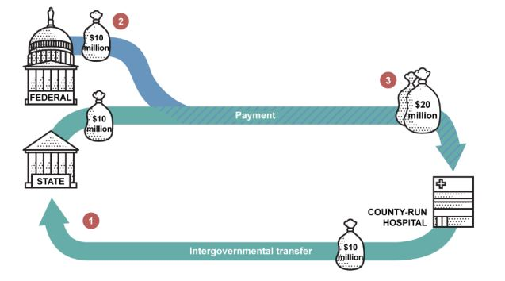
Overview of IGTs
County
1. County transfers $10 million to State DHCS
2. Federal government provides matching federal funds in the amount of $10 million
3. State DHCS makes a $20 million payment to County

Slide 6
Overview of IGTs
IGT amount equals the local/county match required for approved Medi-Cal services
Medi-Cal service
Medi-Cal Fee Schedule
Medi-Cal Aid Code
Federal Medical Assistance Percentages
Any Prop 30/State General Fund amounts
Behavioral Health Plan Administration and Utilization Review will require IGTs
Proposed 15% of direct service payments for BHP Administration
UR based on hours and costs
FFS/MC hospital payment process is proposed to remain unchanged
State pays hospital in full
State receives FFP
State offsets 1991 realignment for local match (Managed Care Offset)

Slide 7
Overview of IGTs-Example
Medi-Cal Beneficiary receives 45 minutes of therapy from a provider
Provider enters CPT code 90834 into Behavioral Health Plan’s claiming system which has a rate of $242.10 per unit of service for the BH Plan
BH Plan submits claim to DHCS’s Short-Doyle/Medi-Cal system
SD/MC system adjudicates claim and determines $121.05 is federal share and $121.05 is local/county share
BH Plan provides $121.05 IGT and receives $242.10 payment from the State

Slide 8
Comparison of IGTs to CPEs
Certified Public Expenditures (CPEs) are a permissible source of local funding used to receive federal Medicaid matching funds
Local government entities certify that they have incurred a CPE on items and services that are eligible for Medi-Cal funding
CPEs do not require a transfer of funds between government entities

Slide 9
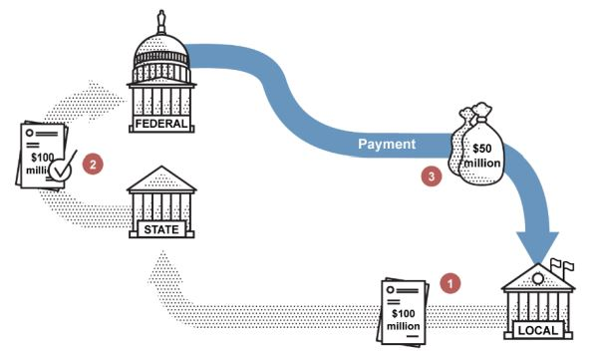
Comparison of IGTs to CPEs
1. County incurs CPE of $100 million and submits certification to State DHCS
2. State DHCS reports the $100 million CPE to the federal government
3. Federal government provides $50 million in federal matching funds

Slide 10
Comparison of IGTs to CPEs
CPEs
Requires a full expenditure be incurred by the local agency for Medi-Cal eligible services
Local agency can not claim for Medi-Cal services until a service has been provided and a CPE has been incurred
Rates claimed for services equal the costs incurred by local agency
IGTs
Requires a transfer of local matching funds to State DHCS
Local agency can claim for Medi-Cal services after service is provided irrespective of timing or amount of actual expenditures
Rates claimed for services are not required to equal the costs incurred by local agency

Slide 11
Comparison of IGTs to CPEs-CPE Example
Medi-Cal Beneficiary receives 45 minutes of therapy from provider and provider incurs 15 minutes documentation time
Provider enters Mode 15, Service Function Code 40 into Behavioral Health Plan’s claiming system which has a contract rate of $4.00 per minute of service for the provider
BH Plan pays provider $240 for 60 minutes of Mode 15, Service Function Code 40
BH Plan submits $240 claim to DHCS’s Short-Doyle/Medi-Cal system
SD/MC system adjudicates claim and determines $120 is federal share and $120 is local/county share
BH Plan receives $120 payment from the State

Slide 12
Allowable and Non-Allowable IGT Funding Sources
42 CFR Section 433.51(c) generally requires that Federal funds cannot be considered as the State’s share in claiming Federal Financial Participation
Exception for Federal funds that are authorized by Federal law to be used to match other Federal funds
Behavioral health funds that cannot be used to fund IGT
SAMHSA Mental Health Block Grant
SAMHSA Substance Abuse Block Grant
Behavioral health funds that can be used to fund IGT
1991 and 2011 Realignment
Mental Health Services Act (to the extent permissible by the Act)
State General Fund
County General Funds

Slide 13
Cash Flow
County Behavioral Health Plans will generally incur an expenditure in addition to providing the IGT
Source of IGT does not have to be the same as the expenditure
Could create cash flow issues for County BH Plans
DHCS has developed several proposals to help mitigate cash flow issues
County Fund Accounts (CFAs) would lessen the time required for the county to receive full payment
*Information on CFAs is pre-decisional (DHCS policy still in development as of 10.13.22).

Slide 14
Overview of County Fund Accounts (CFAs)
DHCS has proposed “County Fund Accounts” (CFAs) for use as the IGT
Each county would have two CFAs
One for Medi-Cal Specialty Mental Health and one for Drug Medi-Cal/DMC-ODS
DHCS is proposing to start with three months of estimated IGT funding as the CFA fund balance
Based on individual county historical approved claims
For each approved claim, DHCS would withdraw funds from the CFAs to use as the IGT
If a CFA does not have sufficient funding to meet the IGT obligations of a claim, DHCS will “pend” the claim until sufficient funding has been deposited into the CFA
*Information on CFAs is pre-decisional (DHCS policy still in development as of 10.13.22).

Slide 15
Overview of County Fund Accounts (CFAs)
DHCS will provide a monthly CFA report to the county
Beginning balance
Monthly transactions
Ending balance
Recommended IGT amount necessary to maintain appropriate CFA balance
DHCS has proposed a withhold or wire transfer process
DHCS will hold claims if insufficient funding is in the CFA
This incentivizes the county to supply funds promptly
*Information on CFAs is pre-decisional (DHCS policy still in development as of 10.13.22).

Slide 16
Next Steps
Register for the November 3rd IGT webinar
Relationship between CFAs and IGTs
Determining optimal funding sources to use as IGTs
Withholds and wire transfers
IGT and CFA reconciliation considerations
IGT and CFA dispute resolution process
Education of County Stakeholders on IGTs and CFAs

Slide 17

Questions & Answers
Please type your questions in the chat

Slide 18

Post-Training Evaluation
Please click on the link in the chat box and answer questions to provide feedback

Slide 19
Thank You
Thank you for attending this webinar!
The recording and slides will be available on our website on the following day.
Please send your questions/comments to paymentreform@calmhsa.org.

